Slide 1
Application Security Verification Standard 4.0
Josh Grossman, OWASP ASVS Project co-leader
November 2019 – OWASP Israel
Notes:
What is the ASVS

Slide 2

Time for a Quiz!
This Photo by Unknown Author is licensed under CC BY

Slide 3
Time for a Quiz!
Who has heard of OWASP?
Who has heard of the OWASP Top 10?
Who can name every one of the OT10 2017?
Who has heard of the OWASP ASVS?
Who can tell me every section in the ASVS?
Notes:
Unfamiliar but super important
I hope to show why

Slide 4
Today, I will be mostly discussing….
What is the OWASP ASVS?
What is new in the 4.0 version?
What makes it interesting?
How you can you use it and get involved?

Slide 5


Slide 6

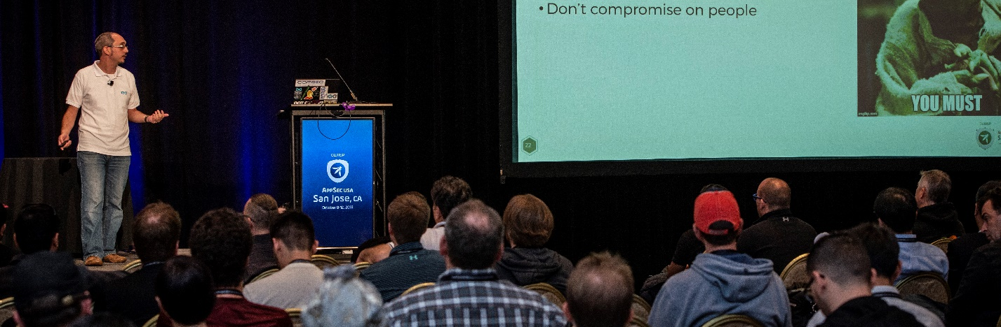
Josh Grossman
Over 10 years of IT Security, IT Risk and development experience
Application Security Consultant and Head of Security Services for AppSec Labs
Consulting for clients as well as speaking and training both internationally and locally

Slide 7


Josh Grossman
OWASP Israel Chapter Board member
Contributor to the OWASP Top Ten Proactive Controls project
Minor Contributor to OWASP Top 10 Risks and OWASP JuiceShop projects
Co-leader of the OWASP ASVS Project

Slide 8
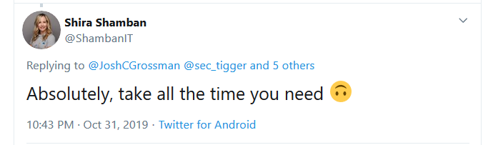
So WHAT IS THE ASVS?

Slide 9
So WHAT IS THE ASVS? Well first, what isn’t the Asvs

Slide 10
The OWASP Top 10 Risks – The Good
OWASP releases every 3-4 years a list of the 10 Most Critical Web Application Security Risks:
Led by security experts from around the world who have shared their expertise.
Andrew van der Stock, Neil Smithline, Torsten Gigler, Brian Glas
Significant public comments and conversation on Top Ten 2017 choices
https://github.com/OWASP/Top10/tree/master/2017
Frequently cited application security awareness document

Slide 11
The OWASP Top 10 Risks – The less good
Spread awareness regarding Web Security issues. It is not a standard.
Take note, PCI-DSS and others who incorrectly list it as one.
Not a comprehensive list
Bringing problems, not solutions
Notes:
No detail on exact issues
Or on fixes

Slide 12
OWASP Top Ten Proactive Controls
Guidance document
Developer/builder focussed
Define Security Requirements
Leverage Security Frameworks and Libraries
Secure Database Access
Encode and Escape Data
Validate All Inputs
Implement Digital Identity
Enforce Access Controls
Protect Data Everywhere
Implement Security Logging and Monitoring
Handle All Errors and Exceptions

Slide 13
Top Ten Proactive Controls – The Good
A great starting point
Gives practical prevention details
Also a great team:
Katy Anton, Jim Manico, Jim Bird

Slide 14
Top Ten Proactive Controls – The less good
Still not comprehensive
Again more for awareness
Not organised as a standard
Notes:
Awareness/starting point

Slide 15

So, watcha gonna do?

Slide 16
The OWASP ASVS!

Slide 17
What is the ASVS?
Requirements for a secure application
Designed to be an actual application security standard
Notes:
An actual standard

Slide 18
What is the ASVS?
Requirements for a secure application
Designed to be an actual application security standard
Set of leading practices
Community and practitioner driven in the open
Split into 3 levels of requirement
Notes:
Things that should become the norm, eye on 2021, 2022
Things that you might not expect
Driven by the community, many eyes

Slide 19
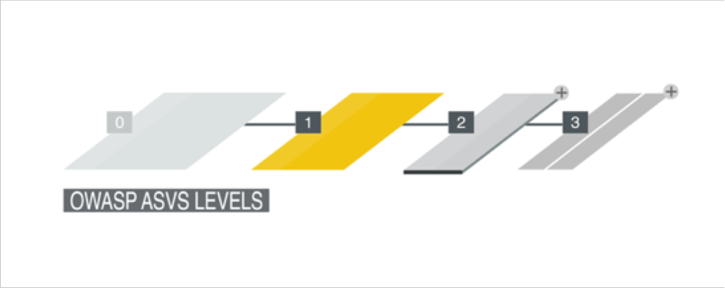
ASVS Level 1
Considered the “minimum” level
Designed for lower assurance levels
Vital stepping stone
~130 requirements

Slide 20
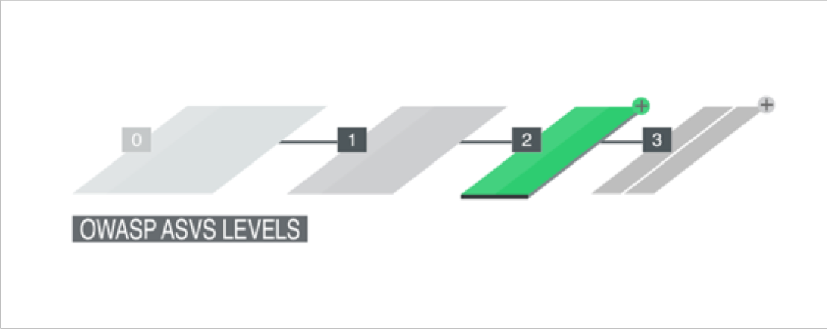
ASVS Level 2
Considered the “standard” level
For applications that contain sensitive data
Provides additional protections
Recommended level for most apps
~130 additional requirements

Slide 21
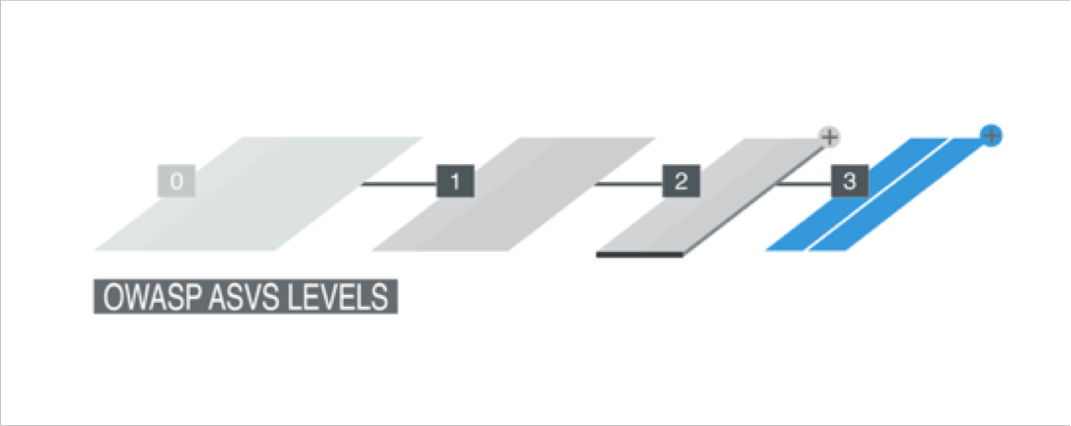
ASVS Level 3
Considered the “advanced” level
For the most critical applications
High value transactions
Sensitive medical data
Any other application that requires the highest level of trust.
~20 additional requirements

Slide 22
Who is involved?
Andrew van der Stock, Daniel Cuthbert, Jim Manico, Josh Grossman, Mark Burnett
Amazing contributors and reviewers such as Abhay Bhargarv, Elar Lang, ossie-git, Ron Perris, Tonimir Kisasondi, Serg Belokamen, Jason Axley, and Adam Caudill
You
Thanks to Andrew van der Stock for the slides that I based this deck on ☺

Slide 23
So what’s new?

Slide 24
What’s new
Now completely written in Markdown
Use script to generate other formats
Easy to determine what changed, when, by whom, and why
Easy to translate
NIST 800-63b compliance
Mappings (Proactive Controls, CWE, NIST, Cheat Sheets)
PCI DSS 6.5.x
Notes:
Easy to contribute, incremental changes
Digital Identity Guidelines: Authentication and Lifecycle Management
More about NIST later

Slide 25
What’s changed
Basically everything
Renumbered completely
Each section is reorganized and re-ordered
De-duped. Do not omit any section for your level
Notes:
Use all of the sections

Slide 26
L1 is the new minimum
Level 1 is considered the minimum
It is also now almost completely penetration testable
Stop penetration testing. White-box/Grey-box/Hybrid reviews at least!

Slide 27
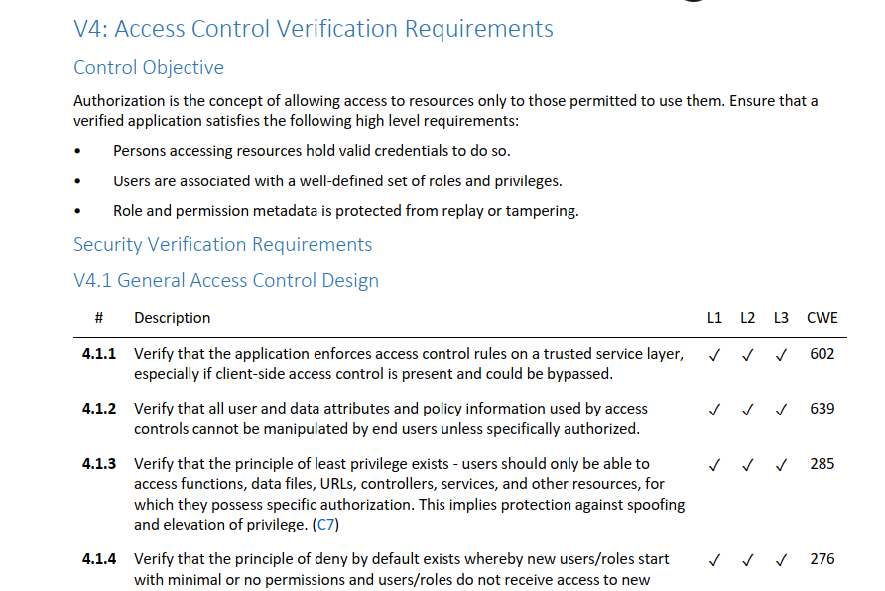
Notes:
This is what it looks like
Authentication
Some intro text and then controls built into sections
ID numbers, Level indicators, mapping to proactive controls, mapping to CWE, NIST mapping

Slide 28
ASVS Sections
V1: Architecture, Design and Threat Modeling
V2: Authentication
V3: Session Management
V4: Access Control
V5: Validation, Sanitization and Encoding
V6: Stored Cryptography
V7: Error Handling and Logging
V8: Data Protection
V9: Communications
V10: Malicious Code
V11: Business Logic
V12: File and Resources
V13: API and Web Service
V14: Configuration
Notes:
Not going to do one by one
Do something more focussed

Slide 29
What makes it interesting?

Slide 30
What makes it interesting? THE OWASP ASVS TOP 10 COOL features!!!

Slide 31
#1 – Revamped architecture section
V1 section completely revamped
Replaces “dead” section with something that can produce secure by default software
Covers architecture requirements for other sections
Requires Secure Software Development Lifecycle
Requires threat modeling
Design and build security in!
Levels 2 and 3 only
Notes:
Have to be built in from the start

Slide 32
ASVS Sections
V1: Architecture, Design and Threat Modeling
V2: Authentication
V3: Session Management
V4: Access Control
V5: Validation, Sanitization and Encoding
V6: Stored Cryptography
V7: Error Handling and Logging
V8: Data Protection
V9: Communications
V10: Malicious Code
V11: Business Logic
V12: File and Resources
V13: API and Web Service
V14: Configuration
Notes:
Not going to do one by one
Do something more focussed

Slide 33
#1 – Revamped architecture section
V1 section completely revamped
Replaces “dead” section with something that can produce secure by default software
Covers architecture requirements for other sections
Requires Secure Software Development Lifecycle
Requires threat modeling
Design and build security in!
Levels 2 and 3 only
Notes:
Have to be built in from the start

Slide 34
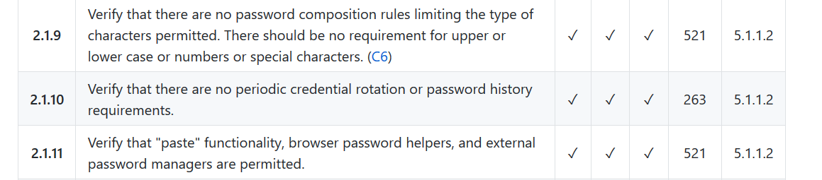
#2 – NIST Alignment
Aligned with NIST 800-63b
Except we had to go to 12 characters for SFA passwords
Notes:
Extra mapping
8 characters is a big nope….
Latest guidance

Slide 35
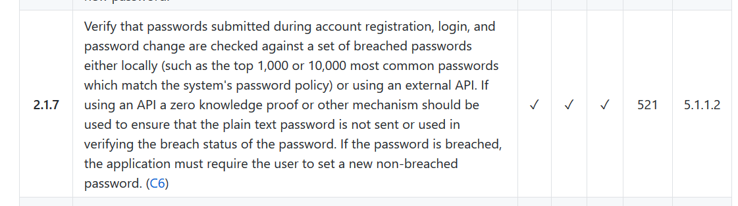
#3 – Useful practices
For example, https://haveibeenpwned.com/Passwords
Notes:
Credential stuffing – when was the last time a pen test picked that up for you?
Compare to known bad lists
haveIbeenpwned
Or top 10000

Slide 36
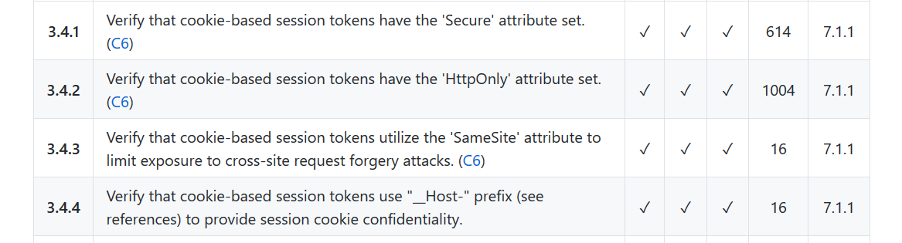
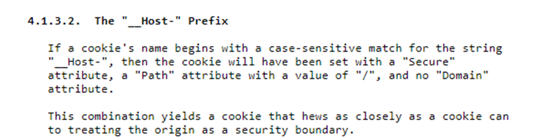
#4 – New, emerging protections
https://tools.ietf.org/html/draft-ietf-httpbis-rfc6265bis-03
Notes:
Cutting edge
https://tools.ietf.org/html/draft-ietf-httpbis-rfc6265bis-03
Secure, simple path and no domain

Slide 37
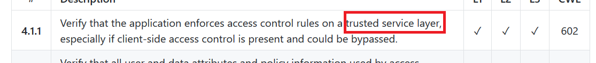
#5 – No more servers
Covers serverless and cloud access control (”server-side” is gone)
Notes:
Where do you verify access control? – Not the server-side anymore

Slide 38
#6 – Today’s vulnerabilities, today
Server Side Request Forgery is the new hotness
But not yet in the OT10….
Notes:
SSRF is everywhere
Not as popular in 2017
Need a standard to stay relevant
Doesn’t need to replace something in a top 10

Slide 39
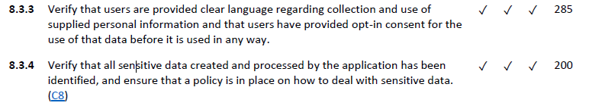
#7 – The Data Protection trend
Notes:
FAST – GDRP

Slide 40
#8 – Not just the obvious
Notes:
normal use?
Using the application in a technically valid but undesirable way

Slide 41
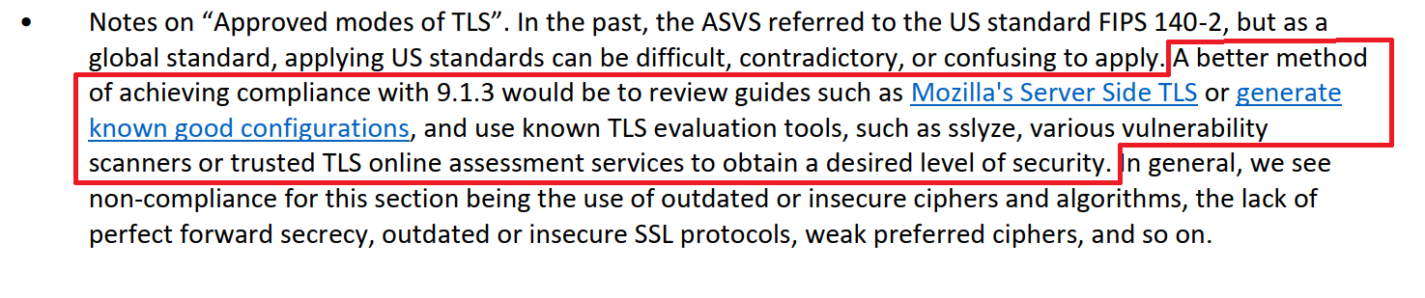
#9 – But how do I do it…?
Notes:
Focus on current leading practice
Cheat sheets
Use updated tools and config builders

Slide 42
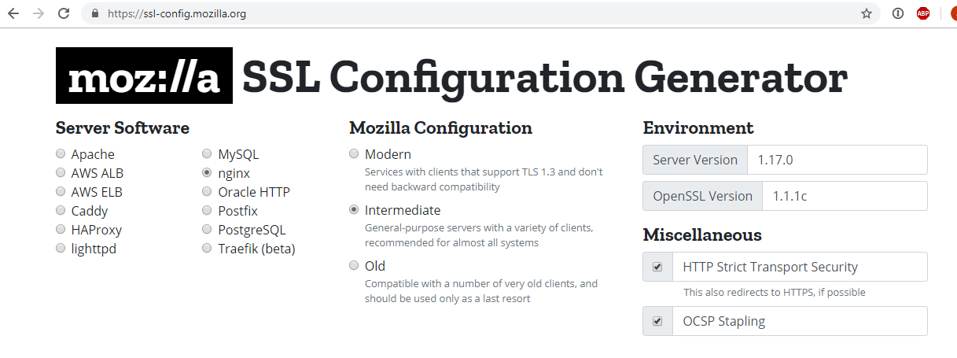
#9 – But how do I do it…?

Slide 43
#10 – Spawn of ASVS!
Mobile Application Security Verification Standard
Container Security Verification Standard
Software Component Verification Standard
IoT Security Guidance / IoT ASVS Appendix
Smart Contracts Security Verification Standard (Not OWASP)
Active Directory Security Verification Standard (Not OWASP)
Verification Standard Security Verification Standard…

Slide 44
I’m in. How do I use it?

Slide 45
Using the ASVS
Using the ASVS for software requirements/developer guidance (SDLC)
Using the ASVS in the procurement process
Using the ASVS risks identification and for test/audit plan

Slide 46
When can I get it?
The ASVS 4.0.1 Final is available now!
OWASP Wiki – Word, PDFs, CSVs, and Hot Linkable markdown
GitHub – Most Recent Static Version is in the 4.0.1 branch
https://github.com/OWASP/ASVS/tree/v4.0.1
GitHub – Development Version is in the master branch
https://github.com/OWASP/ASVS
You can also get the base version of this presentation so you can give this to your local chapter, school, college, or workplace! (Thanks to Andrew van der Stock!)

Slide 47
How to get involved
Grab a copy today and start to migrate from earlier versions and T10
We need translations. Please join the #project-asvs channel on OWASP Slack
We need case studies! If you use ASVS, we’d love to hear from you!
Create issues or pull requests if you identify issues
https://github.com/OWASP/ASVS

Slide 48
Thank you
josh.grossman@owasp.org (OWASP)
josh@appsec-labs.com (work)
@JoshCGrossman (Twitter)
https://github.com/OWASP/ASVS (ASVS on GitHub)

